Slide 1

Training for the
Ministry of Hospitality
Office for Parish Life
Diocese of Scranton
Bernadette Rudolph
Director for Family & Community Development

Slide 2

I. Overview of This Resource
Greeter & usher roles & how-to, w/ prayer/song & commissioning
The broader context: baptismal call, servant leadership, evangelization, mercy
The spiritual basis for hospitality
Conversation w/ parish pastoral council or session to discern how to expand hospitality ministry in parish
  Other options for ministry of hospitality
  Method to discern which avenues for hospitality ministry they wish to pursue
  Encourage larger parish community to see of hospitality as everyone’s responsibility
Notes:
This training resource is meant to be flexible: its components can be used in any combination and order as the presenter sees fit. Simply save the slides you need in your own PPT file and rearrange them.
Components include:
The “basics” of teaching the role of the greeter and usher and how they fulfill their ministries, with a prayer/song to start and a commissioning prayer to end.
A theology of the ministry of hospitality
The spiritual basis for hospitality, which is the foundation for actually being hospitable: there are multiple avenues for approaching this. These could be woven together with other components, taken individually or serve as a spiritual retreat for ministers of hospitality.
Leadership Formation &/or Creating a Parish-wide Lifestyle of Hospitality
other options for the ministry of hospitality,
a method for a parish group to discern which avenues for hospitality ministry they wish to pursue and
how to encourage the larger parish community to see the ministry of hospitality as something everyone is responsible for.
This could stand alone as a conversation with parish pastoral council or be a session the participants do at the end of the rest of the training to discern how to expand hospitality ministry in their parish.

Slide 3
II. Prayers and Songs
Notes:
II. Prayer
Because this is training for ministry, it is most helpful to include prayerful reflection in the training. Here are some songs and prayers the instructor can use. They can be used at the beginning or ending of each session. Another option is to use these during the session to break up the flow of information with reflective time so that participants can absorb and prayerfully ruminate on what they are learning. There are also some suggestions for blessing the ministers at the end of their training. Some prayers can be sent home with the participants to use when they are getting ready to minister.

Slide 4
A. Songs
“A Place at the Table,” Lori True
“All Are Welcome,” Marty Haugen
“Christ Has No Body Now But Yours,” Steven C. Warner
“Come to the Feast,” Marty Haugen
“Come to the Water,” John Foley SJ
“Gather Us In,” Marty Haugen
“Gathered as One,” Deanna Light
“God Has Chosen Me,” Bernadette Farrell
“Table of Plenty,” Dan Schutte
“We Are the Light of the World,” Jean A. Greif
“We Come to Your Feast,” Michael Joncas
“Enter,” John Angotti
“Go, Make a Difference,” Steve Angrisano

Slide 5
B. Prayers
Christ, be with me,
Christ before me, Christ behind me,
Christ in me,
Christ beneath me, Christ above me,
Christ on my right, Christ on my left,
Christ where I lie,
Christ where I sit,
Christ where I arise,
Christ in the heart of everyone who thinks of me,
Christ in the mouth of everyone who speaks of me,
Christ in every eye that sees me,
Christ in every ear that hears me.
Salvation is of the Lord.
Salvation is of the Lord.
Salvation is of the Christ.
May your salvation, Lord, be ever with us.
Notes:
These prayers can be used in training sessions:
“The Breastplate of St. Patrick”

Slide 6
Prayers, cont.
Hospitality Prayer #2
Lord, give us the eyes of Jesus to see our neighbors and the strangers we meet. Teach us what it means to love the stranger as we love ourselves. Forgive us for our selfishness, for our silence, for not caring enough for the strangers who come to our communities. Teach us to love and care for the stranger the way you do. Amen.
-Rebecca Jiménez Yoder
Hospitality Prayer #3
Welcoming and gracious God, whose love and compassion are boundless, place in us a desire to greet each person we meet with the same love, compassion, and respect we would show to you. Help us to see your face in every person, and to serve your people with dignity and care. Bless us as we seek to love as you loved, and serve as you served. We ask this through Jesus Christ, our Lord.
-Archdiocese of Cincinnati

Slide 7
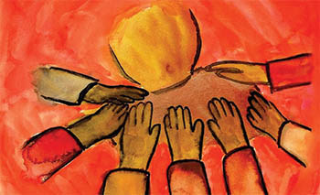
C. Commissioning Prayers
Congregational Blessing for Ushers or Ministers of Hospitality, chapter 62 in The Book of Blessings
Notes:
Congregational Blessing for Ushers or Ministers of Hospitality: can be found in chapter 62 in The Book of Blessings -“This order may be used during Mass or in a celebration of the word of God. This blessing is normally given by the pastor. If necessary, he may delegate another priest or deacon to give the blessing.” (1850-51)

Slide 8

C. Commissioning Prayers
Blessing of Ministers of Hospitality/Ushers:
O God of divine welcome and hospitality, who calls us together with praise and thanksgiving in the Mass, bless these men and women who serve your people as ministers of hospitality/ushers, greeting each person in a Christ-like manner, directing processions in your honor and as a community of faith, and collecting the gifts of your priestly people. Form them to be prayerful, patient, helpful, and understanding in their service to others. Gift them with a friendly and pleasant spirit to those they greet in the mass and throughout their day. In thanksgiving for their service as hospitality/usher ministers we ask this prayer of blessing through Jesus Christ your Son, who lives and reigns with you in the unity of the Holy Spirit, one God forever and ever. Amen.
-Archdiocese of Cincinnati

Slide 9
D. Before Ministering, #1
Heavenly Father,
You sent your Son as a model for hospitality and ministry.
May I have the courage to walk in his ways and serve your people.
Prepare my heart to love all who come through the door today.
Give me eyes to see their needs and gifts,
and grace to respond wisely to each situation.
I ask this through the same Jesus Christ our Lord.
Amen.
-Ferrell & Turner, Guide for Ushers & Greeters
Notes:
Prayer before Ministering #2
Lord, in your love you gather your people this day; help me to serve them in a Christ-like manner, even as your son Jesus served those who gathered about him. Make me prayerful, patient, helpful and understanding, and may I radiate the joy that faith brings as I serve their needs. Give me your strength to support my fellow ministers. May all who assemble to celebrate our common faith in the risen savior be glad of heart for being here and for having encountered your son in one another, in our priest, at the tables of the book and the bread, and through the ministry of ushers like me. I ask this in Jesus’ name. Amen.
-Gregory F. Smith, O. Carm, Quoted by St. Joseph, Keyport, NJ www.stjosephkeyport.org/History%20Ministry%20Of%20Hospitality.pdf retrieved July 17, 2015

Slide 10
Before Ministering, #2
Lord, in your love you gather your people this day; help me to serve them in a Christ-like manner, even as your son Jesus served those who gathered about him. Make me prayerful, patient, helpful & understanding, & may I radiate the joy that faith brings as I serve their needs. Give me your strength to support my fellow ministers. May all who assemble to celebrate our common faith in the risen savior be glad of heart for being here and for having encountered your son in one another, in our priest, at the tables of the book and the bread, and through the ministry of ushers like me. I ask this in Jesus’ name. Amen.
-Gregory F. Smith, O. Carm
Notes:
Quoted by St. Joseph, Keyport, NJ www.stjosephkeyport.org/History%20Ministry%20Of%20Hospitality.pdf retrieved July 17, 2015

Slide 11

III. A Theology of Hospitality

Slide 12
II. Introduction
Deep roots: Scripture
Broad range of activities, attitudes and behaviors.
  Also: way parish community acts/speaks
Transformative
Jesus sees individual
Disciples
We welcome
Belonging
Disciples
Notes:
The ministry of hospitality has deep roots in our tradition, going back to Abraham and Sarah’s gracious welcome of the three angels at Mamre. Scripture also ties hospitality to the generosity of God, making it a spiritual and religious requirement as well.
The ministry of hospitality also covers a broad range of activities, attitudes and behaviors. One first thinks of the formal roles of ushers and greeters. The ministry of hospitality has broadened recently to include some newer ministries, such as a parking team or information team. Furthermore it includes how physically accessible we make our campuses and ministries. Lastly, it also includes the way the whole parish community acts towards and speaks with one another.
When we are welcoming toward others, we imitate Jesus who truly saw each person who came before him for who they were, namely, someone to love. This attentiveness transformed Zaccheus, Andrew, the Woman at the Well and many others. It can likewise transform those who come to worship with us so that they feel they belong to the Body of Christ. This sense of belonging and being loved frees them to enter into the mystery of the Eucharist.

Slide 13
What Is Ministry
  Baptismal Call
    To serve others and to participate in the liturgy
  1Corinthians 12:4-7—different gifts, same Spirit
  Servant Leadership
    We are called to lead lives deeply rooted in service—service to our God, neighbor, self, and creation .
    Serving, one comes to realize that service to God and neighbor is also an act of leadership that differs in kind and orientation from what normally counts as leadership. Christian disciples lead as a result of faith, not because of personal success or institutional commitment.
Notes:
This resource uses the phrase Ministry of Hospitality. What is ministry? Is it okay to use the term for lay people? Each of us is called to ministry by Christ through our Baptism. In Baptism, we are first called to serve others and, because of our baptism, we also have an obligation to participate in the liturgy of the Church.
St. Paul, in his first letter to the Corinthians, tells us that “There are different kinds of spiritual gifts, but the same Spirit; there are different forms of service but the same Lord; there are different workings but the same God who produces all of them in everyone. To each individual the manifestation of the Spirit is given for some benefit.” (I Cor. 12;4-7)
Just as there are different gifts among the members of the Body of Christ, so there are various ministries in the life of the Church.
Through prayer and reflection, we must discern the gifts we have and God’s call to share those gifts with the Church and the world.
In his Pastoral Vision for the Diocese of Scranton, Wounded and Loved, Regathering the Scattered, Bishop Bambera uses the story of Jesus washing the feet of the disciples (Jn 13) as the foundation for his vision of servant leadership. The italicized quotes are taken from p. 6.

Slide 14
The Experience of Welcome
Remember a time you felt welcomed.
How did it change you?
Notes:
To ground the theology that follows, please consider your own experience of hospitality.
The instructor may wish to invite people to share their stories in groups of 2 or 3 or, if the group is not too large, with the whole group.

Slide 15


Belonging: Our Hunger for Home
Sometimes you wanna go
where everybody knows your name
and they’re always glad you came.
You wanna be where you can see
the troubles are all the same.
You wanna be where
everybody knows your name.
Notes:
Your own story of welcome points toward the deep human longing to belong. Everyone has this longing; there really are no rugged individuals, despite what American culture promotes. In Arabic the word for human being means “the one who needs to be in relationship with others.” How true that is about us!
Remember this song? → It was so popular, at least in part, because it touched on this longing.
Belonging is the first need of Millenials (before belief and behavior). What does this mean?

Slide 16
For the last few centuries…
Belief
Behavior
Belonging
Notes:
There are three basic building blocks of religion: Belief, Behavior and Belonging. “For the last few centuries, Western Christianity offered faith in a particular way. Catholics and Mainline Protestants taught” that these happened in this order: 1) Belief, 2) Behavior, and then 3) Belonging. We were baptized as infants and taught catechisms. Children were brought into Church practices and eventually, between ages 7 -15, confirmed, so they now officially and completely belonged. (Bass 201)

Slide 17
Jesus did it this way…
Belief
Behavior
Belonging
Notes:
This is different than Jesus’ method: He began by inviting people to join the community of His disciples. There they learned how to behave by following the Way. This behavior in turn created a new way of seeing, a new set of beliefs. (Bass, 207)
Consider the “Bread of Life Discourse” in John 6. When Jesus explains that people must eat his body in order to be saved, many leave. Jesus turns to the disciples and asks if they will go too. Peter says in reply, “Lord, to whom can we go? You have the words of eternal life. We have come to believe and know that you are the Holy One of God.” (John 6:68-69)

Slide 18

What Is Revelation?
A Body of Knowledge
Notes:
Part of the reason for this change has to do with changes in how we talk about knowing about God. We call how we know about God Revelation and the way we picture it has a big impact on how we “do” Church. For several centuries, as a result of the Enlightenment (in the 17th -18th centuries), the Church saw Revelation as the activity of us studying or learning about God. Revelation was therefore a Body of Knowledge to be mastered. So we wrote catechisms and memorized questions for Confirmation and saw even God as something to be studied.

Slide 19
Revelation = Relationship
Revelation
Evangelization
Hospitality
Notes:
But Vatican II reminded us that Revelation is first and foremost about God reaching out to us to have a relationship with humans. So now what we “do” at church and as Christians is primarily about relationship building. When we come to mass, our main focus is not wondering how late we can be and still count it as meeting our Sunday obligation. It is to fall further in love with God (and with each other). It’s about relationships. When we hear the call to evangelize, our focus is not on setting all those wrong people straight. It is on sharing the Good News that God is in love with each and everyone of us! Again, it is about relationships.
And what is more essential to relationship-building than hospitality? Hospitality makes possible the in-breaking of God into the lives of others. It allows for what Sherry Weddell calls the first threshold of conversion, which is Trust. If trust doesn’t happen, I will not ask questions, I will not engage, and I certainly will not make a commitment to the God I cannot see, if the people I can see are rude and cliquish.

Slide 20
Welcome in the Bible
Abraham & Sarah
(circa 1800 BCE)
Three visiting angels –who knew?
Pleases God →Promise of Isaac’s birth.
“Entertained angels.”
Ps 23: 5-6
You prepare a table before me
in the presence of my enemies;
you anoint my head with oil;
my cup overflows.
Surely goodness and mercy shall follow me
all the days of my life,
and I shall dwell in the house of
the Lord my whole life long.
Notes:
Now that we have reflected on the need for welcome and belonging, let’s look at its roots in Scripture and Tradition:
1. Hospitality was a value in Middle Eastern society as far back as the time of Abraham and Sarah (circa 1800 BCE) in Mamre (Gn 18: 1-8). Three visitors who turn out to be angels bless Abraham and Sarah for their hospitality by promising them a son within the year. Granted, they had been promised descendants as numerous as the stars and the grains of sand already, but the generosity they show their guests moves God to make a definitive promise of Isaac’s birth. Abraham and Sarah did not initially know who the three visitors were; the fact that they welcomed anyone seems particularly pleasing to God. Many have noted the value of hospitality in this story. In fact the writer of Hebrews encourages in Heb 13:2 : “Do not neglect to show hospitality to strangers, for by doing that some have entertained angels without knowing it.”
2. In Psalm 23, the Lord models hospitality in a way that gives great comfort to the singer. The singer finds safety, security, food, honor and distinction, forgiveness, goodness and a home with the Lord. Who has not read this and thought, “Oh, I would love to have that!”

Slide 21
Divine Expectations
Mt 25:34-40
Then the king will say to those at his right hand, “Come, you that are blessed by my Father, inherit the kingdom prepared for you from the foundation of the world; for … I was a stranger & you welcomed me… “
Then the righteous will answer him, “Lord, when was it … that we saw you a stranger & welcomed you?”
And the king will answer them, “Truly I tell you, just as you did it to one of the least of these who are members of my family, you did it to
me.”
Notes:
Throughout Scripture God models hospitality and pointedly calls on us to show it. Perhaps the most pointed of these is in the Parable of the Last Judgment late in Matthew’s gospel. In this familiar passage from which we get six of the seven Corporal Works of Mercy, the King of the World easily divides people into two groups. Although we often focus on feeding the hungry and clothing the naked, one of the requirements is welcoming the stranger. Of especial note in this passage is that these works of mercy are the only thing required for entrance into heaven! God does not want to know how many times we went to mass or how many novenas we said. While these are good activities, the bottom line for God is how we have shown compassion, including in our welcoming!

Slide 22
“How Welcoming Am I?”
I am a welcoming presence in my parish.
I am welcoming in my facial expressions & mannerisms.
I see Christ in others. Do others see Christ in me?
I greet people as I approach the church & in the gathering space.
I speak positively about the Catholic Church, my parish, my pastor, etc.
I am inclusive.
I participate in the Mass to give glory to God and give good example to others.
I extend Christ’s peace to others, looking them in the eye and acknowledging everyone around me.
Notes:
Knowing that Scripture says hospitality is so important, let’s take a look inward at how well we are hospitable – particularly at church.
Invite personal reflection.

Slide 23

“How Welcoming Am I?”
A strength you have for hospitality
An area you’d like to develop
Notes:
Based on the answers the audience found in the previous slide’s reflection…
Answer these 2 questions and share with your neighbor.
Collect as a large group and write on a flip chart, using two columns.

Slide 24
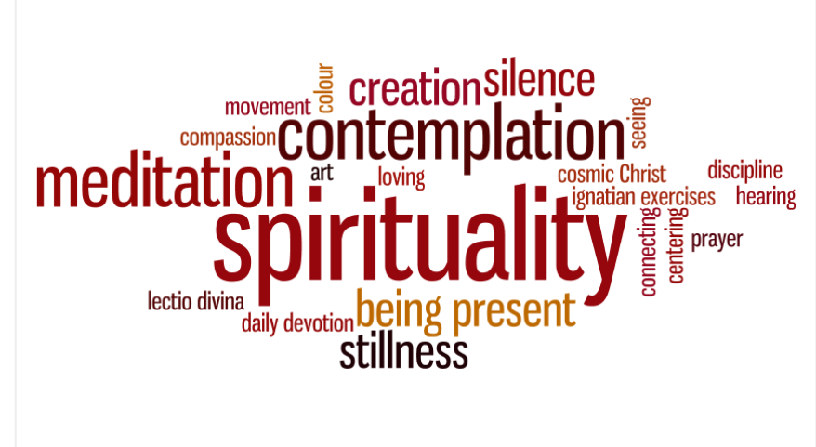
IV. A Spirituality of Hospitality

Slide 25
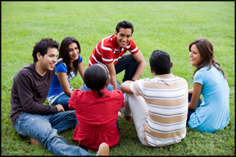
Foundations:
A. Seeing Christ in Others
“Very truly, I tell you, whoever receives one whom I send receives me; and whoever receives me receives the one who sent me.” Jn 13:20
“For where two or three
are gathered in my name,
I am there among them.”
Mt 18:20
Notes:
Two interior efforts are needed to undergird a ministry of hospitality.
The first is seeing Christ in others. In John’s “Last Supper Discourse,” Jesus tells the disciples, ”Very truly, I tell you, whoever receives one whom I send receives me; and whoever receives me receives him who sent me.” (Jn 13:20)
A second familiar passage comes from Matthew 18.
Notice that in both of these passages Jesus does not say that it will be like meeting him or like meeting the one who sent him. It will actually be Jesus. It will actually be God. Jesus will actually be with us when we have a heartfelt one-on-one or gather in a larger group.

Slide 26
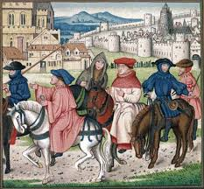
Foundations:
A. Seeing Christ in Others
All guests who present themselves are to be welcomed as Christ, for he himself will say: I was a stranger and you welcomed me (Mt 25:35).
-Rule of St. Benedict
Notes:
This beautiful spiritual discipline of seeing Christ in others continues throughout Church history. We find an example in the Rule of St. Benedict. When Benedict wrote a guide for monastic life in the sixth century, there were still no hotel chains spaced regularly along a traveler’s route as we have today. People had to rely on the hospitality of those living along their route. Although many think of monasteries as places where people go to get away from their fellow humans, Benedict challenged monks to respect the command of Christ in the Parable of the Last Judgment. And monasteries that follow his rule today continue this ministry of hospitality.

Slide 27
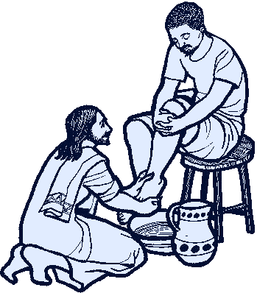
Foundations:
B. Being Christ for Others
“So if I, your Lord and Teacher, have washed your feet, you also ought to wash one another’s feet. For I have set you an example, that you also should do as I have done to you.”
-Jn 13: 14-15
Notes:
The second interior action that undergirds a ministry of hospitality is being Christ for others. When Jesus washes the disciples feet at the Last Supper, he is clear that they must carry out similar acts of humble service. Biblical scholars tell us that this lesson-action in John’s gospel explains the meaning of the suffering and death Jesus is about to undergo. His service is a self-sacrifice through which others might have life. His disciples must likewise pour themselves out for the lives of others.

Slide 28


Foundations:
B. Being Christ for Others
Christ has no body but yours,
No hands, no feet on earth but yours,
Yours are the eyes with which he looks
compassion on this world,
Yours are the feet with which he walks to do good,
Yours are the hands, w/ which he blesses all the world.
Yours are the hands, yours are the feet,
Yours are the eyes, you are his body.
Christ has no body now but yours. -St. Teresa of Avila
Notes:
This interior attitude has likewise been passed along in Church Tradition. St. Teresa of Avila in the sixteenth century beautifully spelled out the need for us to be Christ in the world today.
Prayerfully consider –reaction?

Slide 29
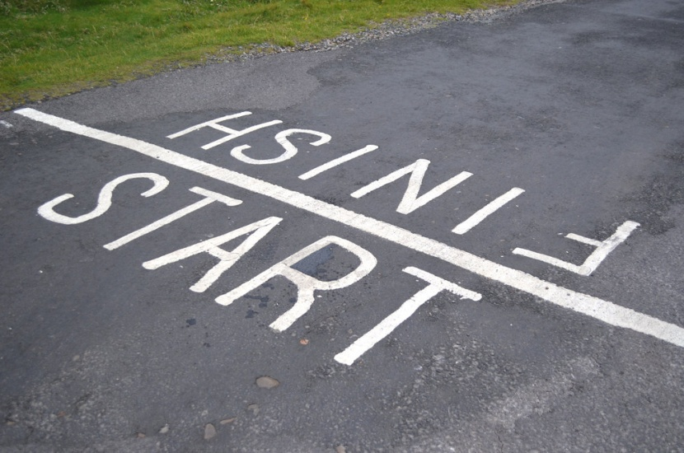
Hospitality Evangelizes
We greet Christ in one another long before we receive him in the sacrament of Communion.
-Ferrell & Turner
Those on the margins… and those in the pews
Notes:
More recently, in their lovely book, A Guide for Ushers and Greeters, Kerrie Ferrell and Paul Turner remind us that “We greet Christ in one another long before we receive him in the sacrament of Communion.” They are speaking particularly about the value of those ministries, but this idea can be broadened even further. If we are not bringing Christ to people in our day-to-day lives, the Eucharist will not be effective. It may be the source and summit of our lives as Catholic Christians, but it will have no meaning to us or others if it is not made real in our day-to-day interactions with others.
So we come full circle: Hospitality evangelizes. If I can be Christ for others, they can begin to hear the Good News. They can begin to have a relationship with God.
And this Good News is needed both by those who are not connected with our church and by those who are coming weekly. Do not assume that those who attend church regularly know of God’s love. Everyone needs to hear the Good News that God is wildly in love with them.
Then they need to hear it again and again and again. Conversion is a lifelong process and so evangelization is a lifelong need.

Slide 30
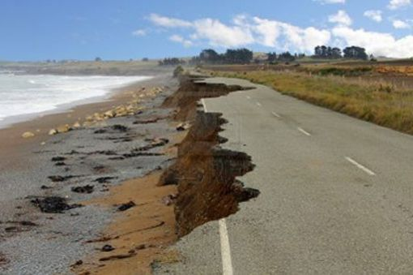
Mercy:
Becoming the
Welcoming
Face of God
EVERYONE is in need of God’s love.
“A church is a hospital for sinners, not a museum for saints.”
-Pauline Phillips
“The Church is always in need of reform.”
Notes:
Furthermore, hospitality is an avenue for being merciful. During the Jubilee of Mercy in 2016, Pope Francis drew our attention to the fact that Mercy is a key attribute of God. He called Jesus the Face of the Father’s Mercy and encouraged us to bring this same mercy to everyone., without judgment.
Sometimes, however, we get caught up is judging the worthiness of those who come to mass. We must remember that everyone, even the priest, is in need of God’s saving love. If we didn’t need it, we could do something else with our time. None of us can save ourselves. We must all come to the feast.
As Dear Abby wrote, the church is a hospital…
This same sentiment was captured in a medieval maxim of the Church, revived by the bishops at the Second Vatican Council.

Slide 31

Personal Formation
After Mass & throughout the week, strive to cultivate a hospitable heart. Work on the demeanor you will bring with you to church. This works both ways. Your service at church will also help you keep a kindly spirit at home and at work throughout the next week.
-Ferrell & Turner
Notes:
How can we work on developing this spirituality as individuals and as ministers of hospitality? Ferrell and Turner suggest ...

Slide 32
1. Be welcoming
Say hello to everyone.
Don’t force yourself on others.
Learn people’s names.
Learn from the way people welcome you.
Be a good guest.
What would this look like?
Notes:
Here are five practices that a person can use during the week to nurture a spirit of hospitality. Questions are included for personal reflection or for group discussion -- or both!

Slide 33
Be Welcoming, cont.
Your reaction when the phone rings: Inconvenienced? Is it noticeable in your voice?
Tele-marketers: Hang up on them? Refuse to listen to them? Get angry? Politely turn them aside?
Email or texts: Read messages carefully? Prompt in responding? Ever respond with rage?
A stranger asks for help: Eager to be of service or anxious to get away?
Appearances: If the person has a different skin color, accent or clothes, do you get tense? Do you avoid persons of a certain age? Are you more likely to help the handsome & beautiful than the sick & disfigured?
Notes:
Use this list for self-examination.

Slide 34
What would you need to do
to become more welcoming?
If you made these changes, what do you think
would be the outcome?
Notes:
Gather other ideas for #1, Be Welcoming: Where could you start? Would it be comfortable?
Ask people to think for 2 minutes about the question.
Let them share with 1-2 people around them or with large group.

Slide 35
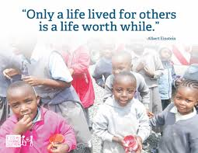
2. Discern needs.
What are some of the needs you see around yourself?
How tuned in are you to the needs of others?

Slide 36
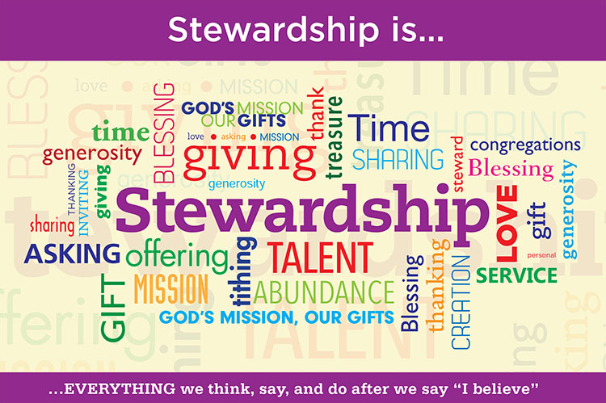
3. Be Prudent & Trustworthy
Gratitude to God
Gratitude to others
Generous w/ Time, Talent and Treasure
What are you grateful for?
How are you offering your time, talent and treasure now? How has doing so changed you?
Notes:
All we have is God’s, comes from God and needs to be returned to God
→We are stewards.
Be generous with time, talent & treasure
→Appreciate sacrifices & gifts of others
→Personality will change: think less of self/things & more of others
WHAT ARE YOU GRATEFUL FOR?
How are you offering your time, talent and treasure? → HOW HAS IT CHANGED YOU?
10MINUTES

Slide 37
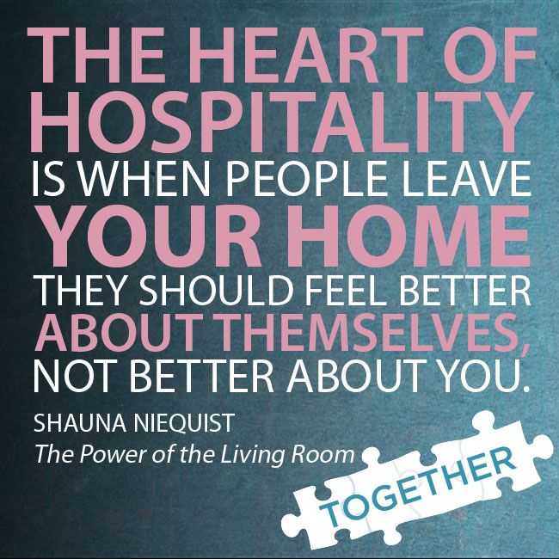
4. Be Part of the Team
At home (or in your community):
Who is responsible for the hospitality?
Do you let everyone have a role?

Slide 38
5. Be Prayerful
At Mass: Martha
or Mary?
All Week
How well do you do worshiping when you minister?
How could you better worship?
Would it help to prepare readings ahead of time?
Jesus as role model
  What do you know about Jesus’ prayer life?
Focus on God
  When are you most able to focus on God?
  Are there places where you need to let God in?
Notes:
5. Be prayerful
All Week: Give people time to discuss Jesus’ prayer life, then segue into their own prayer life. Regarding the question, “Are there places where you need to let God in?” consider what Ronald Rolheiser discusses in his book, Sacred Fire. Like the rich young man in Mk 10:17-22, many mature Christians have done so much to be good people and are wondering what they can do to become saints (p. 135ff). Rolheiser says we have given God twenty-seven of the thirty rooms in our heart; we need to give over the remaining three. What is holding us back?
At Mass: Let the group discuss the difficulties in being prayerful at mass and how they do/don’t work around them. One suggestion is preparing the readings ahead of time so that they can address the needs of those they minister too and then jump right back into the readings, because they know what they missed.

Slide 39
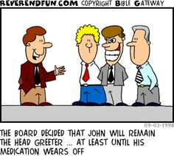
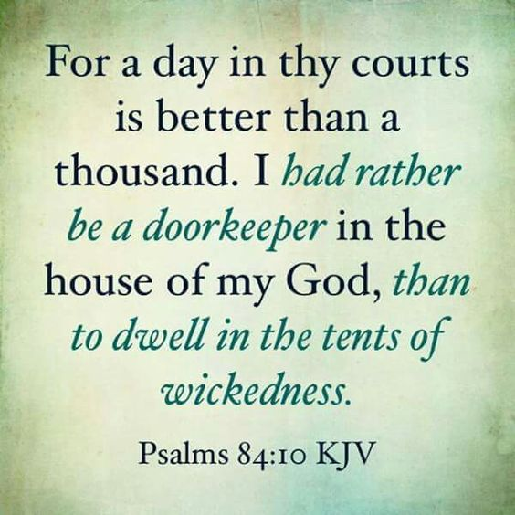
V. Specific Training for Ushers and Greeters

Slide 40
General Intro to Roman Missal (GIRM)
Ushers & ministers of hospitality are among “other functions” in which lay people may serve:
  Those who take up the collections in the church
  Those who, in some regions, welcome the faithful at the church doors, seat them appropriately, and marshal them in processions
May be commissioned to do so:
Liturgical functions that are not proper to the Priest or the Deacon and are mentioned above may even be entrusted by means of a liturgical blessing or a temporary deputation to suitable lay persons chosen by the pastor or the rector of the church.
Notes:
The General Introduction to the Roman Missal, the official Church document which explains how the liturgy of the Church is to be celebrated and why, names ushers and ministers of hospitality among the “other functions” that lay people may serve in the liturgy (besides acolyte and lector). In chapter 3, “Duties and Ministries in the Mass,” these roles are included:
Those who take up the collections in the church
Those who, in some regions, welcome the faithful at the church doors, seat them appropriately, and marshal them in processions. (paragraph 105)
Those serving in these roles may even be commissioned to do so:
Liturgical functions that are not proper to the Priest or the Deacon and are mentioned above may even be entrusted by means of a liturgical blessing or a temporary deputation to suitable lay persons chosen by the pastor or the rector of the church. (paragraph 107)

Slide 41

Possible Characteristics
Is good at making others feel “at home”
Can talk to a lamp post
Is outgoing
Listens attentively
Puts you at ease when you were introduced
Moved in the parish and/or understands what it is like to be on the outside.
Notes:
Part of how we figure out what God wants of us is by paying attention to the gifts with which God has equipped us. Some characteristics of a person who would be good in any of the ministries of hospitality might include these. If this isn’t you, maybe your gifts would be better suited in another ministry. Your ministry should be a blessing for both you and the people you serve; having many of these qualities is a good predictor for that.

Slide 42
A History of the Ministry of Usher
Oldest lay ministry in the Catholic Church
Ushers in the Bible
“Keepers of the threshold” collected money offerings from the people (2 Kings 22:4)
Also 1Chronicles 9:19
Jeremiah 35:4 –Shallum = keeper of the threshold
1Chronicles 26 -classes of gatekeepers kept watch 24/7
Nehemiah 7:45 -138 gatekeepers returned to Jerusalem after the Babylonian exile
Later, included as members of Levites who ministered at the Temple
Notes:
This history is courtesy of St. Joseph Parish in Keyport, NJ.
The ministry of ushers is the oldest lay ministry in the Catholic Church. The ushers of today have descended from a long line of people of God who have gone before them.
Ushers in the Bible
The Second Book of Kings speaks of the “keepers of the threshold” who collected money offerings from the people (2 Kings 22:4).
Guardians of the threshold are also mentioned in 1Chronicles 9:19.
Jeremiah 35:4 calls Shallum a keeper of the threshold.
1Chronicles 26 lists several classes of gatekeepers who kept watch twenty-four hours a day.
Nehemiah 7:45 notes that 138 gatekeepers returned to Jerusalem after the Babylonian exile.
After that time, they seem to have been included as members of the Levites who ministered at the Temple.

Slide 43

Ushers in Christian History
During time of Christ, hundreds of doorkeepers of temple
Clerical order of porter:
  Letter of Pope Cornelius notes doorkeepers serve Church of Rome, 3rd cent.
  Apostolic Constitution, 4th cent.
  Includes doorkeeper or porter
  Duty: guard against intruders
Notes:
During the time of Christ, the doorkeepers of the temple numbered in the hundreds and were the forerunners of today's ushers.
The more immediate predecessor of today's usher can be found in the clerical order of porter. The third-century letter of Pope Cornelius mentions doorkeepers serving the Church of Rome. The Apostolic Constitution, a fourth-century Syrian Church document, also speaks of the role of doorkeeper or porter. During those times, it was the duty of the porters or ushers to guard the door of the church against any intruders who might disturb the service.

Slide 44
History of Ushers, cont.
Middle Ages: porter = one of 4 minor orders (carrying out some original functions of deacons)
  Thomas Aquinas - porter duties ="to ring the bells, open the church and sacristy, to open the book for the preacher."
  The minor order of porter → all those seeking ordination to the priesthood
Pope Paul VI suppressed minor orders (1972) → task goes to laity
VCII’s renewal of liturgy - foster community's full participation in liturgy from time one enters church to worship
Notes:
In the medieval period, the role of porter was one of the four minor orders, which Thomas Aquinas described as carrying out some the original functions of deacons in the church. The porter duties were specified as "to ring the bells, open the church and sacristy, to open the book for the preacher." The minor order of porter was conferred on all those seeking ordination to the priesthood.
Pope Paul VI suppressed all the minor orders in 1972 and this important task was given over to the laity. For generations, ushers have assisted parish worship by welcoming people, helping them find seats in church, taking up the collection and passing out parish bulletins.
In the renewal of the liturgy from the Second Vatican Council, this ministry has undergone a further transformation. Now the ministers are called to perform tasks intended to foster the community's full participation in the liturgy from the time one enters the house of God to worship.

Slide 45
Greeters, #1
Purpose: create atmosphere of welcome
  Build new relationships
  Develop ongoing relationships
Nametags ↑ relationships!
  Parish rep
  Lets newcomer see greeter’s name
Arrive 15-20 minutes early & stand at the doors
  Outside the door and open it?
Greet EVERYONE
What to say:
  Welcome!
  So glad you have come!
  Thank you for coming!
  How are you today?
  I like your hair/coat/
  dress/shoes/tie!
  Isn’t the weather great/freezing?
  Is everyone awake yet?
Notes:
The roles of greeter and usher are different from parish to parish, where they may be separate ministries or one combined ministry. How a parish defines them is determined by the history and culture, as well as the understanding of liturgy of the parish. If they are separate ministries, here is a general description of what they include:
Greeters
Greeters are responsible for creating an atmosphere of welcome. They begin to build a relationship with each newcomer and they develop relationships with parishioners.
Relationship building starts with a nametag, which
a) allows the person arriving at the church to know that this person is a representative of the parish community and
b) begins the relationship by letting the newcomer see the greeter’s name. (Most people are visual learners so seeing the name is more helpful than just hearing it said.)
Greeters should arrive 15-20 minutes before the mass begins and stand at the doors. If the weather is not inclement, they can stand outside the door and open it for people while greeting them.
It is essential that they greet EVERYONE, not just their friends.
They can say one of the following or something equally friendly.

Slide 46
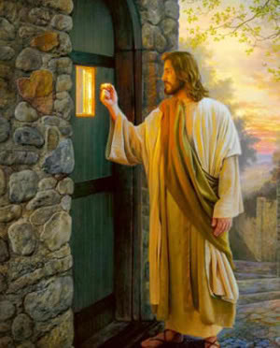
Greeters, #2
Help visitor find a seat → briefly explain missal
  Sit w/ non-Catholic visitor to guide?
A smiling face
  Non-verbal expression
  How culture expresses welcome & love
Source of information about building & parish
During mass, be friendly to those seated nearby
MAYBE: say good-bye as people leave & hand out bulletins
  Reinforce the love of God & concern of community
  Smile & “Have a great week!” or “Looking forward to seeing you next Sunday!”
→Positive impression: “I belong!”
Notes:
If someone is a visitor, the greeter should help them find a seat. The greeter can also briefly explain the missal/songbooks the parish uses. It may be helpful to ask if they are Catholic; if they are not, the missal is essential to following along with the complex ritual of the mass. The greeter may sit with the non-Catholic visitor during the liturgy to help guide them.
A smiling face is absolutely essential to this ministry! The majority of human communication takes place through non-verbal expression, so a greeter must make sure that his/her face and body are saying what his/her mouth is saying. Welcome and love are expressed in our culture in large part by looking happy to see the person and that definitely includes smiling at them.
The greeter is a source of information about the building and the parish. The greeter should be familiar with the parish campus –exits, bathrooms, handicap accessibility, the location of the shrine or Eucharistic adoration chapel, for example—and the parish itself –how to register for the parish or for religious education, parish office hours, when the Bible study meets, who to contact about joining the men’s club, for example. Studying the bulletin can help with this; it is also important to know the parish staff.
The greeter does not have any responsibilities during the mass but should continue to be friendly to those seated nearby.
If it is the purview of the greeters, after the Prayer after Communion, they should go back to the doors of the church to say good-bye as people leave and to hand out bulletins. Like the greeting before mass, this is an opportunity to reinforce the love of God and the concern of the community for each person who has attended. A smile and a “Have a great week!” or “Looking forward to seeing you next Sunday!” gives the person a positive final impression that, “This is a place where I belong.”

Slide 47

Ushers, #1
Purpose: help liturgy flow
  Direct seating & movements outside pews
  Take up collection
Need to be kind, pleasant & Christ-like
  Speak politely & treat w/ welcome & respect
  Each person is a child of God & worthy of love.
Name tags important
  Official representative of parish
  Begin relationship by easy sharing of the usher’s name
Notes:
Ushers
The ministry of usher is primarily to help the liturgy flow smoothly. Ushers direct the congregation’s seating and movements outside their pews and take up the collection.
While the ministry of usher may seem to be less personable and more about logistics or crowd control, it is nevertheless a ministry of hospitality and requires that ushers be kind, pleasant and Christ-like. Ushers will find that the old adage, “You can catch more flies with honey than with vinegar,” is quite true: people will cooperate more if they are spoken to politely and treated with welcome and respect. This is done, not out of a sense of manipulation, but rather because each person is a child of God and worthy of love.
As for greeters, name tags are an important starting point. Name tags establish that the usher is an official representative of the parish; they also allow a relationship to begin by the easy sharing of the usher’s name.

Slide 48
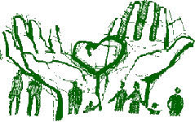
Ushers, #2
Arrive 20-25 mins early to tidy up pews & entrances
Assist w/seating, esp. at crowded liturgies or after mass starts
  Families w/ small children
  Persons in wheelchairs or with walkers or canes → need communion in pew?
  Those w/ difficulty hearing
Source of information about building & parish
Notes:
The ushers should arrive 20-25 minutes before the liturgy begins, so they can tidy up the pews and entrances if needed. This may include straightening out the door mats, removing extra bulletins and trash from pews and/or replacing missals or hymnals.
Ushers assist with seating, especially at crowded liturgies or after the mass has begun. Ushers can help families with small children decide on seating that is best for them. Ushers should know where the seating is for persons in wheelchairs or with walkers or canes. The ushers should check if these people will need communion brought to them in the pew or if they can come up to the sanctuary and then convey that information to the Eucharistic ministers. The ushers should also know where the sound is best for those with difficulty hearing and/or where to sit if the parish has a sign language interpreter.
Like the greeter, the usher is a source of information about the building and the parish. The usher should be familiar with the parish campus –exits, bathrooms, handicap accessibility, the location of the shrine or Eucharistic adoration chapel, for example—and the parish itself –how to register for the parish or for religious education, parish office hours, when the Bible study meets, who to contact about joining the men’s club, for example. Studying the bulletin can help with this; it is also important to know the parish staff.

Slide 49

Ushers, #3
MAYBE invite someone to take up gifts
  Give clear directions
  Be there to assist during liturgy
Help latecomers find a seat
Know how to handle overflow crowds
Balance being a full participant in liturgy & assisting others
  Preparing readings ahead of time
  Praying before coming to church
Notes:
In some parishes, before mass begins, it is the job of the ushers to invite someone in the congregation to take up the gifts of bread and wine. The usher should give clear directions about when this occurs and be available to assist the gift bearers during the liturgy.
As mass begins, the usher should be aware of open seats, so they can help latecomers easily and discreetly find a seat.
Ushers should also know how to handle overflow crowds.
During the liturgy, the usher must strike a balance between being a full participant in the liturgy and assisting others. Because the usher is a representative of the parish, it is important that he/she model prayerful participation. So, it is a good idea for the usher to stand in the back of the church where he/she can direct people to the restrooms or spot medical situations and offer aid. However, the usher should still be attentive to the liturgy, sit, stand and kneel at the appropriate times, and pray and sing. The usher should look at where the action of the liturgy is taking place –the lector, the altar, etc.—and not talk unnecessarily with other ushers or congregants. Preparing the readings ahead of time will allow the usher to easily return to listening to them during the Liturgy of the Word or refocusing on the homily, should someone need something at that time. Praying before coming to church for the Holy Spirit to act through the usher at all times and to make all his/her ministry a loving act of prayer places all the “activities” of ushering in a context of prayer; this may help the usher move between praying the liturgy and ministering as an usher.

Slide 50
Ushers, #4
After Universal Prayer, take up collection
Guide parishioners to communion
MAYBE say good-bye as people leave and to hand out bulletins
  Reinforce love of God & concern of community
  A smile & “Have a great week!” or “Looking forward to seeing you next Sunday!”
→ Positive impression: “I belong!”
Notes:
After the Universal Prayer, the ushers take up the collection. The process varies from parish to parish, so the usher should ask a parish staff member how it should be done. Many people may feel awkward or embarrassed about the collection. The ushers can smooth things out by once again finding a balancing point for their behavior:
smiling and making eye contact but not staring;
giving people enough time to get their money out but not waiting too long as if to say, “Where is it?”; and
keeping things moving, but not being conspicuous, pushy or jostling people.
If a parishioner is taking too long, the usher should offer to come back or tell him/her where to put the check after mass. If the parish uses baskets, the usher should be alert to parishioners who get confused and move the basket to the next pew.
As the priest, deacon and Eucharistic ministers are receiving the bread and wine, the usher should come to the front of the area he/she is to guide to communion. As the ministers move into place, the usher should invite the people in the first pew to come to the station to receive. The usher steps back to let one pew of people out at a time. The courteous host always eats only after the guests have been served; so likewise with the ushers, who should receive when everyone else has done so.
If it is the purview of the ushers, after the Prayer after Communion, they should go back to the doors of the church to say good-bye as people leave and to hand out bulletins. Like the greeting before mass, this is an opportunity to reinforce the love of God and the concern of the community for each person who has attended. A smile and a “Have a great week!” or “Looking forward to seeing you next Sunday!” gives the person a positive final impression that, “This is a place where I belong.”

Slide 51
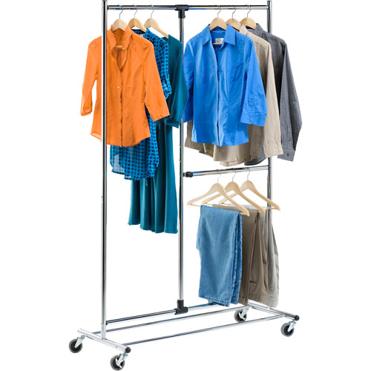
Attire
Clothing makes a statement.
  Formal or informal?
  Uniform or individual?
Clean, without rips and modest → no one is offended
Making 1st impression for parish
Ask pastoral staff what message they would like you to send.
Notes:
Clothing makes a statement. It can be formal or informal. It can be uniform –think matching suit coats or matching polo shirts –or individual. No matter what, it should be clean, without rips and modest, so that no one’s sensibilities are offended as the hospitality minister makes a first impression on behalf of the parish. Ministers should find out from pastoral staff what message they would like to send, i.e. how to dress.

Slide 52
Troubleshoot Emergencies
Know the parish plan for emergencies, including weather.
Know how to reunite children in religious ed. w/ families.
Emergency exits, fire extinguishers, defibrillators & first aid kits?
Take a first aid course.
Parish plan to deal with violence
Silenced cell phone →911
Your ambulance is too loud!
Notes:
Troubleshooting Emergencies: Each parish needs to set up plans for dealing with emergencies before the emergencies happen. Usually there is little time for thought during an emergency, so a well-rehearsed strategy means you have a greater chance of reducing harm and returning to normal more quickly.
Ministers of hospitality should know what to do in case of an emergency. They should learn and follow the parish plan for handling emergencies, including for weather emergencies common in the geographical area.
They should know how to reunite children in religious education with their families if needed.
They should know the emergency exits and locations of the fire extinguishers, defibrillators and first aid kits.
Ministers of hospitality may wish to take a first aid course so that they will be better prepared to help as needed.
They should know the parish plan to deal with violence.
They should keep a silenced cell phone with them to call 911 if needed.
Do you have this information? Where could you get it?

Slide 53

Troubleshoot Disruptions
Be compassionate: bring Christ to situation and people
Children = part of the Body and to be welcomed. If adult brings noisy child to back of church:
  kind word
  offer of help
  directions to cry room or nearby space, if needed
Adult: gently, firmly lead to place where you can talk
  Need another minister for safety
Notes:
Disruptions:
When disruptions occur –and they will– ministers of hospitality should be compassionate. It is important to remember that they are bringing Christ to the situation and to the persons involved.
Children are part of the Body of Christ and welcome even if noisy. If an adult brings a noisy child to the back of the church, the minister of hospitality can assist with a kind word, an offer of help and directions to a cry room or nearby space, if needed.
If an adult is disruptive, the minister of hospitality should gently but firmly try to lead him/her to a place where they can talk. The minister should be sure to have another minister go with him/her for safety.

Slide 54



C. Practicum
Persuading people to move into a pew from the aisle seat or to sit in the front rows
Running out of seats at a special liturgy, like Christmas or Easter
Being told the bathrooms are out of paper towels or toilet paper
Handling a medical emergency
A homeless person asks you or other parishioners for help.
The fire alarm goes off.
An animal enters the church.
Notes:
Practicum: You may wish to role play scenarios where participants get to act out how they would welcome people and/or troubleshoot problems. Some potentially troublesome situations include:
Persuading people to move into a pew from the aisle seat or to sit in the front rows
Running out of seats at a special liturgy, like Christmas or Easter
Being told the bathrooms are out of paper towels or toilet paper
Handling a medical emergency
A homeless person asks you or other parishioners for help.
The fire alarm goes off.
An animal enters the church.

Slide 55
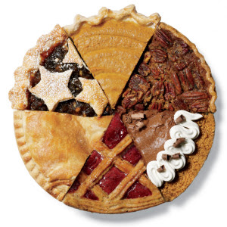
VI. Other Parish Ministries of Hospitality
Notes:
Greeters and ushers are only 2 slices of the Hospitality pie. What else could a parish do formally?
What follows are suggestions. Pick and choose what your parish can work on, but don’t think you must do it all at once. Rome wasn’t built in a day!

Slide 56

Parking Information
Team directs traffic
Helps people find spots
Indicates handicap parking
Knows street parking rules
Especially useful at masses with large crowds
→Clarity keeps potentially sinful area
flowing smoothly
Join parish, Rel. Ed.
Get mass cards, sponsor cards, etc.
Any info they would have had to come to office for
Notes:
Parking Team
The need for a parking team ministry is dependent on the size and location of the parish. A large, urban parish will more likely need this than a small or rural parish with ample parking. However, this ministry can be particularly useful any time there is a larger-than-usual crowd expected, like Christmas, Easter or First Communion.
Parking can be stressful in several ways. It can be hard to find a spot, especially for a family with children who is running late or for an elderly driver, who may have special concerns or be easily confused. A newcomer will have no idea what the parking arrangements and traffic flow are. People who are eager to leave in a hurry can create an occasion of sin for themselves and others.
The parking team relieves these tensions by directing traffic in a courteous and friendly way. As a result, parishioners and newcomers can enter and leave the church campus in a much more spiritual, relaxed and Christian frame of mind. Patience, smiling, saying “please” and “thank you” as well as “hello” and “good-bye” are small but significant ways to bring the love of God to others and to keep the wheels of progress well oiled.
Members of the parking team should arrive 25-30 minutes before mass begins. They help people find spots to park and keep the flow of traffic moving smoothly. They indicate handicap parking and assist those with physical disabilities to get in and out of their cars as needed. They know the local laws for street parking and share that information as needed.
Members of the parking ministry team should also be present at the end of mass to keep the flow of departing cars moving smoothly.
Information Team at Weekend Masses
One way to welcome people is to make getting what they need as easy as possible. Asking people to come to the parish office during the week can be burdensome. Since most parishioners come to the parish only on weekends at mass time, a parish can set up an information table where parishioners can get a mass card, get a sponsor card, register or find out most information they would have to come to the office for.
People who minister on the Information Team should be at a separate and clearly marked table in the gathering space. They should be friendly people who are organized and good at explaining information clearly and concisely. They should arrive 15-20 minutes before mass and be at the table again as the closing procession is happening. Smiling and giving information in a cooperative, respectful manner shows the inquirer that he/she is a valued member of the community.

Slide 57
Fellowship
Bakers
Food/drink + visiting time = Relationships
Room to mingle
NOT out of the way
Rel. Ed. parents while they wait
Provide a treat after special masses or meetings
Notes:
Fellowship Committee
To move newcomers and parishioners beyond “acquaintances” to “friends” takes time. A parish can provide the time and subsequent opportunity to develop relationships by offering food/drink and visiting time after liturgies. If a parish does not have enough time between masses to accommodate people staying for fellowship, perhaps it could consider lengthening the time between liturgies.
Americans see themselves as busy. Asking them to walk to another building for fellowship usually does not work. This ministry should be located in the gathering space or no further away than the church basement.
Some parishes keep this simple with coffee/juice and donuts. Some have designed a café in a separate room with tables, light supper fare after Saturday liturgies and light breakfast fare on Sunday mornings.
The members of the fellowship committee need to arrive with enough time before mass to prepare the food/drink as much as they can in advance. If more elaborate food/drink is being offered, they may need to attend one mass and minister at another. Fellowship ministers present the food and drink in attractive ways and tidy up the area as people serve themselves. Ministers should be helpful, cheerful and welcoming.
Bakers
Jesus knew that a lot can happen if and while people are fed. They are taken care of physically and so can become aware of spiritual and emotional needs. Conversations can happen. Furthermore, food can be a way that the provider of the food shows love. A parish can likewise communicate hospitality and love by serving food regularly to those who come to parish events.
A parish team of bakers can provide home-baked goodies for special masses or at large/special parish gatherings (for example at the reception after the Easter Vigil.) Serving can be done by the bakers or by others. A notice can go in the bulletin and parish webpage for bakers. This ministry needs a coordinator, who is the contact person for requesting baked goods and who calls the bakers and organizes the baking.

Slide 58
Ministries Brochure/Fair
Belonging and Invitation
Each Member of Body of Christ Brings Unique Gifts
Brochure:
Committee members comfortable w/computer
Pastor’s letter of welcome
Contact info for parish office & staff
Thorough description
Ministry fair:
1-2x/year after masses
In church hall
Each ministry on display
Reps: welcome, inform & sign up new participants
Freebies, drawings, flyers
Organizing committee invites all ministries
Notes:
Ministries Brochure/Booklet and/or Ministry Fair
Many people feel they truly belong to a parish when they begin to participate in its ministries. A ministry brochure or ministry fair functions to let people know what their options are AND to invite them to join. It is important to acknowledge that each member of the Body of Christ has a unique gift valuable to the life of the parish.
A small committee whose members are comfortable using a computer program like Microsoft Word or Publisher could assemble the brochure. It is common to include a letter of welcome from the pastor and contact information for the parish office and staff. The committee compiles a list of all the programs and ministries offered by the parish as well as a GREAT job description of each, the name of the person in charge and contact information, usually a phone number and email address. (SEE the OPL’s Weebly site for Engagement to learn how to write great job descriptions. It is in the “Guide to Developing a Ministry Leadership System” PDF in part 3.) The bulletin and parish web page are good resources for compiling all the ministries as are the parish secretary and pastor.
Some parishes choose to hold a ministry fair once or twice a year after all the masses, often on Pentecost or the parish feast or at the beginning of the school year. The fair should be held in the church hall or building nearby on the same campus. A representative from each ministry and committee is given a table on which to display information about the program or ministry. A representative is there to welcome, talk about the ministry or program and to sign up new participants. Freebies, drawings and, of course, flyers for each program/ministry are helpful. An organizing committee for this fair would reach out to all the program/ministry chair persons to invite their participation and see if they will need anything special for their table (like an electrical outlet for a laptop.)

Slide 59
New parishioners
Folder w/ all parish info that would be helpful
  Census
  Ministry booklets
  Programs interesting to newcomers
  Electronic giving
  Parish mission statement and plan
  Do NOT fundraise
Visit/Call
Meal
  Multiple times/year
  Parish staff &/or parishioners sit with newcomers
  Share parish plan/programs & invite participation
Personally invite to parish events the first year
Notes:
Welcome Committee for New Parishioners
The parish office staff will need to notify the welcoming committee of new parishioners at regular intervals.
There are several ways that a parish can welcome new parishioners. The first is to assemble a folder with helpful parish information such as:
Parish web address, email address, contact information (maybe on a refrigerator magnet?)
A census form or directions for it on the parish website
Ministry brochure
Information on the parochial school or parish religious education programs
Flyers for programs that match the newcomers
Information on electronic giving
Parish mission/vision statements, core values and 3-5 year plan
Members of the welcoming committee can assemble the folders and keep the information up to date. Make sure you provide only relevant info. (For example, no need to explain the elementary religious education program to a family with only high school-aged children.)
These folders can be delivered by mail, but are more effective at welcoming if they are accompanied by a phone call or a home visit. Members of the welcoming committee can take turns with phone calls and home visits. It is important to be sure that the call or home visit is at a time convenient for the new parishioners. Ministers should be friendly, interested in learning about the new parishioners and able to identify and share pertinent info with the newcomers.
These folders can also be delivered at a parish meal, offered multiple times/year depending on the number of new parishioners. Welcoming committee members would call the new parishioners personally to invite them and find out if they are actually able/willing to attend. At the meal, parish staff and/or parishioners sit with the newcomers --not each other! After the meal the pastor, parish staff, welcoming team members and/or members of the parish pastoral council can speak to the whole gathering about the parish’s 3-5 year pastoral plan and/or programs the parish offers. Importantly, they can invite the newcomers to participate. Just as importantly, they absolutely should NOT fundraise, as this is inappropriate and unwelcoming.
The welcoming committee can personally invite new parishioners to parish events the first year of their membership via a phone call. Spending some time with them at the event itself would further the welcome. Maybe a pool of “sponsor families” could be engaged to take on this ministry, with a sponsor assigned to each new family for the year.

Slide 60

Sacramental Prep
Attitude of welcome
Meet people where they are
Baby-sitting service
Feed so evening meals are not an issue
Child Care
Notes:
Ministry of Hospitality for Sacramental Prep
For better or for worse, many people come to church primarily for sacramental preparation. This means that this is a golden opportunity for evangelization, that is, for helping them to know Christ’s love and how being part of the Catholic Christian community can feed them. Approaching sacramental preparation with an attitude of welcome is foundational. Those ministering in sacramental preparation must be glad that the families have come and make events comfortable. Practically, this looks like offering baby-sitting service during parent meetings and offering a meal (or at least a potluck) during evening meetings so getting everyone fed at home before the meeting is not an issue. It also means that the meeting should be an opportunity for reflection and prayer, not just the passing of information about dress codes and requirements. Theologically and spiritually, ministers must meet people where they are, not where they would like them to be. By the same token, ministers must also challenge the people coming for sacraments to grow beyond where they are now, as Jesus did with the Samaritan Woman (John 4:4-30).
Childcare Ministry
Again, to meet people where they are at, a parish must recognize and work with the real circumstances of parishioners’ lives. If parishes wish to have adults attend events, they must be aware that many adults have school-aged children who cannot be left alone. A childcare ministry can provide childcare for events adults are expected to attend. A clean room with a variety of clean toys, competent adults who are comfortable with children, some organized activities, like games or an art project, and a snack of juice and pretzels/cereal are needed.

Slide 61

VII. Parish-wide Ministry of Hospitality
Notes:
While many Catholics think that Hospitality is the responsibility of people who sign up for a specific ministry, it is a parish-wide ministry. To help develop that idea, leaders need to work on three areas:
Expanding the opportunities for Hospitality ministry beyond greeters and ushers, using the ideas in the previous section –or their own ideas.
Awakening an attitude of welcome in all parishioners
Ensuring that the parish campus is inclusive.

Slide 62
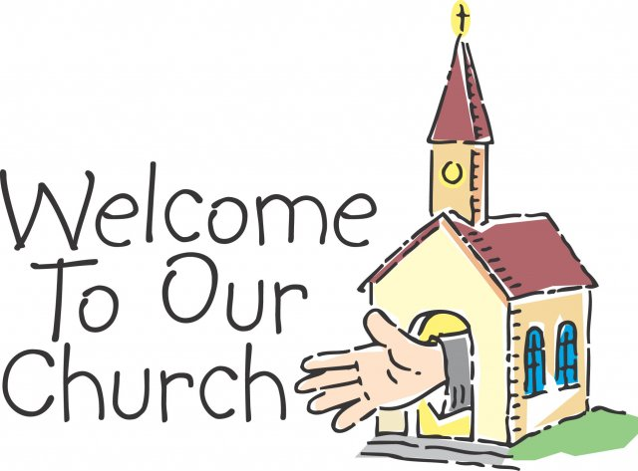
An Air of Hospitality
Create a context for hospitality:
Most parishioners do not know that they should be welcoming.
Part of discipleship
How to?
Homilies
Info Series: in bulletin and/or brief talks at mass
Social media: “I was the welcoming face of Jesus.” or “I saw the welcoming face of Jesus.”
Reflection questions: in pew or home
Notes:
Awakening the Parish’s Welcoming Attitude
One reason a parish may not appear to be very welcoming is because most of the parishioners do not know that they should be. They are comfortable and, resultantly, do not consider how others are feeling. It is essential therefore to alert them to this responsibility, to let them reflect on it and to give them some information on what they can do.
Here are some methods a parish can employ. The first requires the buy-in of the pastor and any priests who preside at the parish liturgies, but it is perhaps one of the easiest and most effective ways to catechize the congregation, namely a series of homilies on the virtue of hospitality and our responsibility toward it. Three or four weeks in a row would provide enough repetition for people to grasp the message. Many gospel readings have hospitality themes or elements, particularly during Ordinary Time or in the Christmas season.
If the pastor is not willing to use the homily in this way, perhaps catechesis could take place through a series of articles/items in the bulletin and/or in a brief talk before mass or after communion. Each week the talk could feature a different concept from the theology or spirituality sections of this PPT. Also there are many online articles (See the Electronic Resources at the end of this PPT or Google “Welcome in Church”) you can reproduce as handouts or bulletin stuffers or include as links on your parish web page.
Since Millenials like to construct their own knowledge, invite them to do so on social media. The parish will create a wonderful collage of ideas – and members will begin to connect hospitality to their lives.
Another way to help people make the connection is to ask them to reflect on thought-provoking questions. Ask people to discuss the question with the person next to them before mass, before or after the homily or after communion. In the alternative, you can send them home with the question to think about during the week or discuss with their family. The next slide has some sample questions.

Slide 63

Discussion Prompts
What does our parish look like thru the eyes of a visitor?
What are we doing now to welcome visitors?
Do you know the names of those who sit by you?
Recall a time you felt welcomed in a strange place. What made you feel that way? Are you and your fellow parishioners doing that now?
What is one thing you can do to help everyone feel at home in our parish?
If you imagine our parish as a model of hospitality, what 3 things would be key?
Notes:
Give people an opportunity to reflect on the message in the homily series, the bulletin inserts or talks before mass/after communion, by asking the following reflection questions and allowing 3-5 minutes for answering. If you use the homily series or the series of talks, ask parishioners to turn to the person sitting closest to them and share their answers. Use 1 question/week.

Slide 64
Is Our Parish Welcoming?
The parish is easily identified w/ name & mass times visible from road.
Church rectory & parking lot are well marked & easily identified.
Rooms & buildings are clearly marked.
Buildings are wheel-chair accessible.
Parking spaces for persons w/ disabilities
Large print missalettes & listening devices available
Hospitality ministers greet & assist people at all masses.
New parishioners are introduced to the community.
Our parish includes those who speak other languages.
We welcome young children, those w/ special needs & persons of all ethnicities.
We reach out in times of grief.
Notes:
There are many parish hospitality assessments available on the Weebly toolkit page where you found this PPT. Here is a quick one to get people thinking.

Slide 65

Honest Looking
What are we doing now to be Christ for others in our ministry as ___________?
What are we doing now to see Christ in others in our ministry as ___________?
Notes:
Here is another way to get people who are involved in all different kinds of ministries to see their piece of the Hospitality pie:
Divide into groups by ministry. Ask to reflect together on both questions and write answers on a T.
Share what you reflected on with the larger group.

Slide 66

Out-of-the-Box
Thinking
What would the experience of belonging look like for someone who interacts with us as ___________ ministers?
What more could we do as ___________ ministers to be the Welcoming Face of Jesus?
Parishioners
Visitors
Nones
Notes:
Here is a second activity for exploring how ministers in areas that are not blatantly about Hospitality can create ways to be more hospitable. Provide each group with markers, a sheet of flip chart paper and gift box. Place gift box in middle of paper and ask them to write their ideas on the paper around the box.
Share with large group.
Ask what is their overall reaction to what they have done and heard. In other words, what have they learned from this exercise?

Slide 67
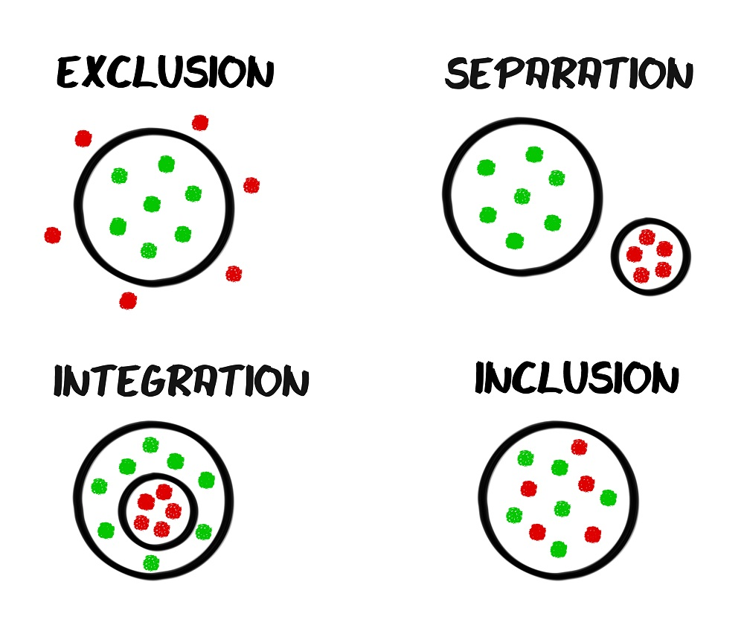
VIII. Inclusion & Accessibility
Notes:
The third element in parish hospitality is creating a welcoming space. Your parish’s physical plant is speaking. Can you hear it? Perhaps not, because you have many experiences with it and the memories of all those experiences are louder in your head. But what if I am a newcomer? What would I hear? What if I have a disability or I am elderly, what would I hear?
Your physical plant speaks loud and clear. It is shouting who is welcome and who is not.
If I am elderly or disabled, can I get in? If I am elderly or disabled, can I serve in a ministry or can I only watch? Keep in mind that Pennsylvania has the second highest percentage of elderly people and that fully 20% of Americans self-identified as having a disability in the last US census. If all are welcome, does our campus reflect that?
And what if I am new, will I be able to find an open door or figure out where a meeting is taking place? Where is the parish office? The rectory? Which building is the school? You all know, but I do not.

Slide 68

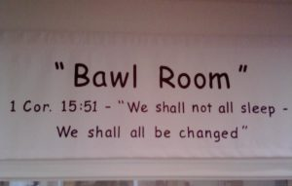
Assessing Ease of Use
Clearly marked buildings and rooms or offices?
How accessible are your buildings for the elderly? For the handicapped?
Even pavement?
Adequate night lighting? Safe?
Pleasant and clean?
Seating for handicapped & elderly? Do EM’s bring the Eucharist to them?
Families w/ small children?
Notes:
The accessibility of a parish campus makes a clear statement of welcome to newcomers and persons with special needs. Conversely, if a person cannot get into the church or church hall, he/she cannot attend the liturgies or church events.
Here are some things to look for:
Are the buildings clearly marked? Would a stranger know which building is which? Would they know where a certain meeting room is?
How accessible are the buildings for the elderly? For the handicapped? (Enter each building with an elderly person and a person with a walker. Where do they struggle?)
Is there at least one bathroom stall that is wide enough for a wheelchair to enter? Are there grab bars?
Check for uneven pavement, adequate night lighting, safety, pleasantness, cleanliness.
Are there places for families with small children?

Slide 69

How do we improve?
Campus Tour by Buildings and Grounds Team
Advocates for Persons with Disabilities
National Catholic Partnership on Disabilities (www.ncpd.org)
Surveys in the Toolkit
Survey your parishioners
Notes:
Ways to work on this:
Many parishes have a Buildings and Grounds Committee, official or unofficial. This group or a subcommittee of it can tour the campus with an eye to how the campus looks to visitors and how easily the elderly and disabled can maneuver it. Take this tour at least every other year, since signs fade and pavement shifts.
Find a parishioner or two to be the Parish Advocate(s) for those with Disabilities. These people will know what to look for both in the buildings and at the events the parish holds. Make as many accommodations as you can. (Get those Buildings and Grounds team members involved!)
Look to the NCPD for assessments for inclusion of the disabled.
Use the assessments from the OPL Hospitality and Welcome Toolkit in which you found this PPT. Many highlight campus accessibility issues.
Survey your parishioners. A quick 10 questions mailed home, distributed in the pews --although if I am already in the pew, access may not be too big an issue-- or through on an online tool like Survey Monkey will tell you what you need to know.

Slide 70

IX. Bibliography

Slide 71
Electronic Resources
Diocese of Scranton’s Hospitality Toolkit
Hospitality: The Doorway to Evangelization
“Is It Time to Move from Friendly to Radical Hospitality?” by Poonam Patodia
“It’s All about the Weekend, Stupid!” Rebuilt, ch 6
“Let’s Give a Warm Welcome: If Parishes Lose the Catholic Tradition of Hospitality They Risk Losing Members” by Heather G. Gary
“Words of Welcome from a Parish” by Thomas Reese
“Welcoming the Stranger” by Richard McCorry
Notes:
Each of these items has a hyperlink.

Slide 72
Print Resources
Forming Intentional Disciples by Sherry Weddell
The Digital Cathedral by Keith Anderson
Engaging a New Generation: A Vision for Reaching Catholic Teens by Frank Mercadante
Reimaging Faith Formation for the 21st Century by John Roberto
Divine Renovation by James Mallon
Guide for Ushers and Greeters by K. Ferrell and P. Turner

